Slide 1
Implementing Association Relationships

Slide 2
Topics:
Implementing association relationships with one-to-one multiplicity between Java classes
Navigating from one instance to another when there is a one-to-one relationship
Using the ArrayList class to create association relationships with one-to-many multiplicity between Java classes
Navigating one-to-many association relationships using methods of the Vector class
Creating and using an association class with Java

Slide 3
Reviewing Class Diagram
Association relationships
  Can be shown as:
    Aggregation relationships
      Strong association where one instance “contains” the other
        E.g., town contains shopping centers or stores
    Composition relationships
      Strong association where one is composed of, or “part of” another
        E.g., walls that are part of a building

Slide 4
Associating Customer with Boat: One-to-One Association Relationship
Each direction of the association relationship must be defined in Java
  Mandatory / optional
  Multiplicity
To implement in Java:
  Use a reference variable of one class as an attribute of another class

Slide 5
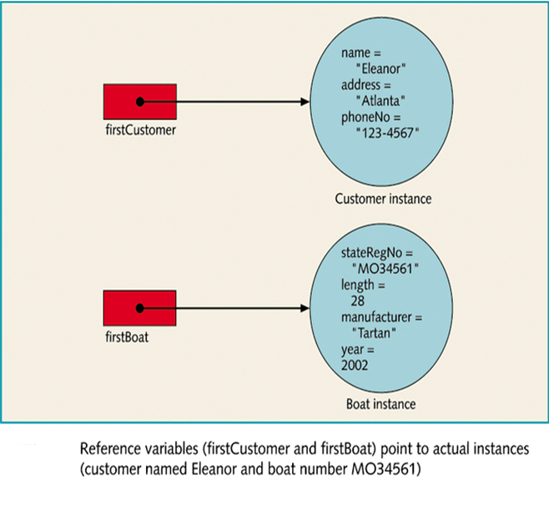

Slide 6
Associating Customer with Boat: One-to-One Association Relationship
Modifying the Customer Class
  To implement a one-to-one association with the Boat class:
    Add an attribute to Customer that holds a reference to a Boat instance
  TesterOneA (Figure 1)
    Tests one direction of association relationship
      A Customer owns a Boat
  Sequence diagram
    Illustrates the interaction in TesterOneA

Slide 7
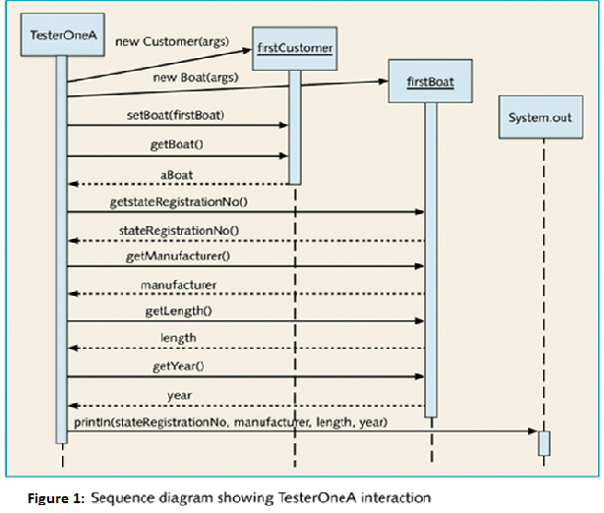
Figure 1:

Slide 8
Associating Customer with Boat: One-to-One Association Relationship
Modifying the Boat Class
  To implement a one-to-one association with the Customer class:
  Add an attribute to Boat that holds a reference to a Customer instance
    Add accessor methods to establish the association relationship in both directions
  TesterOneB (Figure 2)
    Tests both directions of association relationship
      A Customer owns a Boat
      A Boat is owned by a Customer

Slide 9
Adding Capability to the Boat Class
Techniques to increase functionality
  Make relationship mandatory rather than optional
    E.g., when Boat is instantiated, it could require that a Customer be specified
      Thus, only Boats owned by Customers of the business would be accepted into the system
  Modify the Boat’s tellAboutSelf method
    Return information about both Boat and Customer

Slide 10
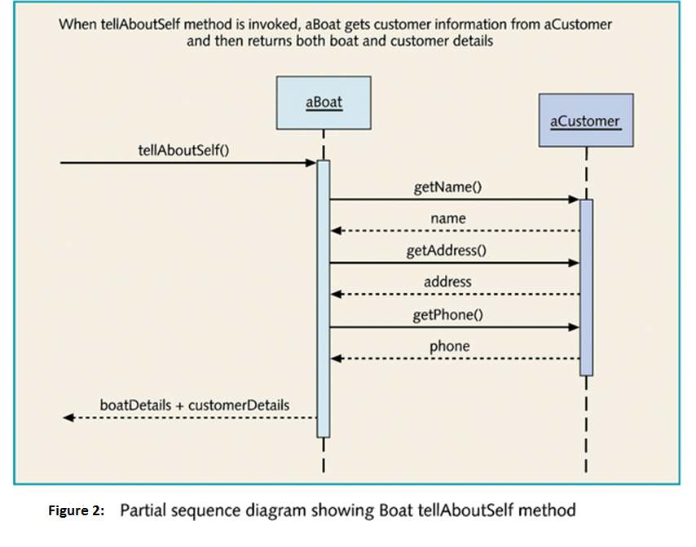

Slide 11
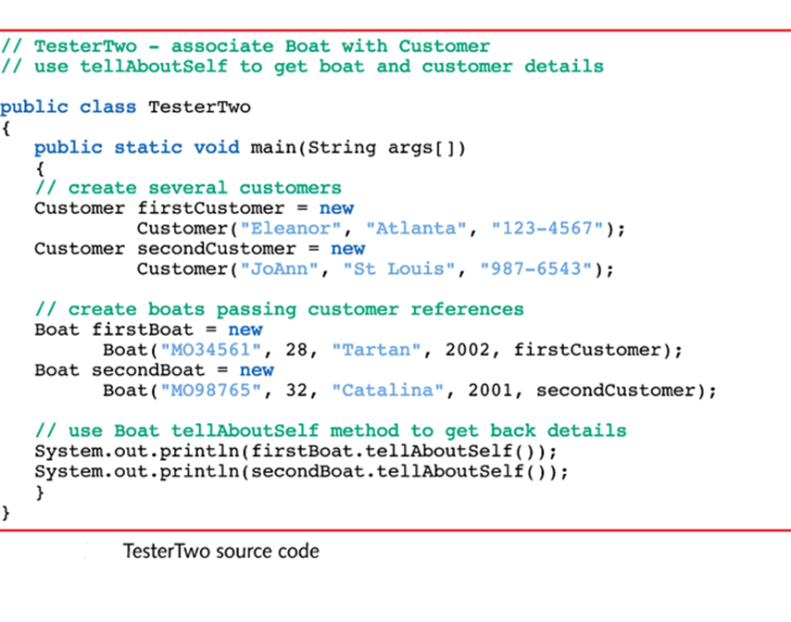

Slide 12
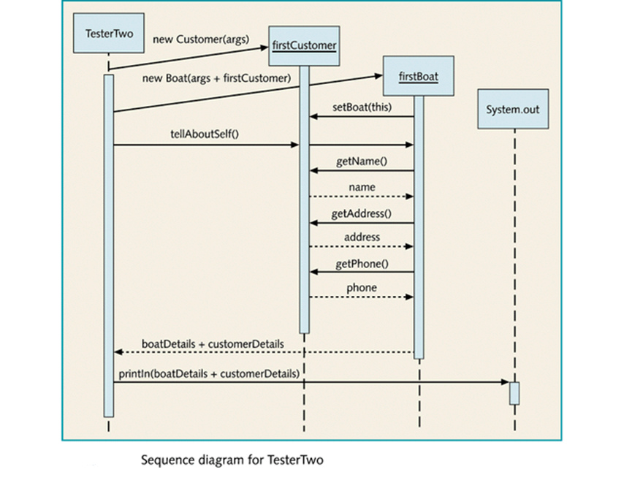

Slide 13
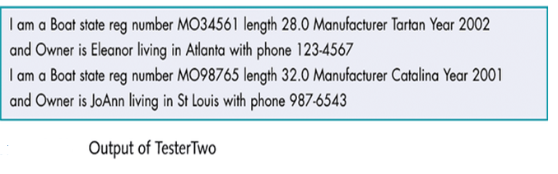

Slide 14
Associating Dock and Slip: A One-to-Many Association Relationship
Dock / Slip Relationships
  Slip and Dock relationship
    A slip is attached to a dock
    One-to-One relationship
      Similar to Customer and Boat relationship
  Dock and Slip relationship
    A dock contains many slips
    One-to-Many relationship
      Requires different approach

Slide 15
Associating Dock and Slip: A One-to-Many Association Relationship
Introducing the Dock Class
  Contains:
    An arrayList attribute
      Implements the one-to-many relationship
    A method that returns the ArrayList attribute reference

Slide 16
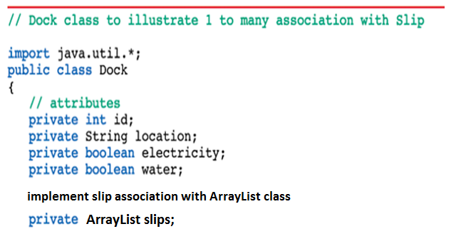

Slide 17
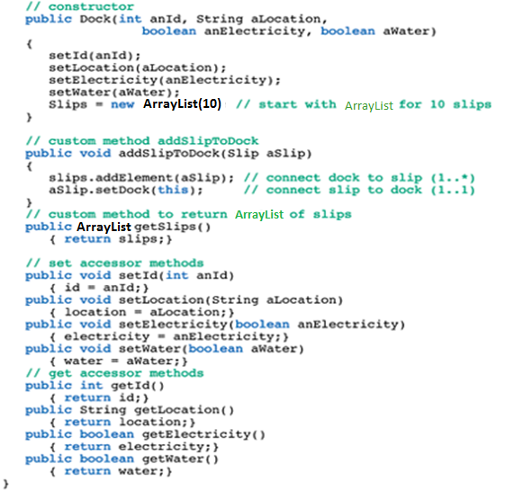

Slide 18
Associating Dock and Slip: A One-to-Many Association Relationship
Associating the Slip Class With Dock
  Modified much like Boat class to implement a mandatory one-to-one association relationship
    Associates slip with dock
  Further modified to also set up a relationship with a Boat
    Associates slip with boat

Slide 19
Associating Dock and Slip: A One-to-Many Association Relationship
Testing the ‘Dock Contains Slips’ Association Relationship
  TesterThreeA
    Tests both directions of association relationship
      One-to-Many
        A Dock has multiple Slips
      One-to-one
        A Slip resides in a Dock

Slide 20
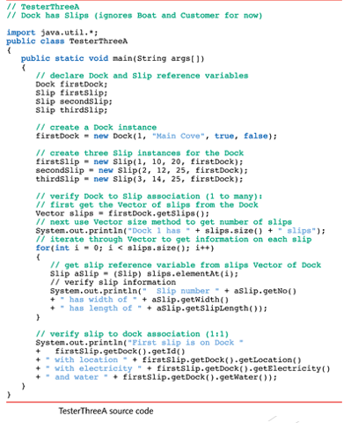

Slide 21
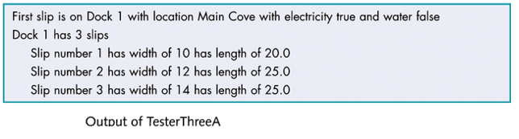

Slide 22
Associating Dock and Slip: A One-to-Many Association Relationship
Adding the Boat and Customer Classes to the Example
  To complete example:
    Modify Boat to associate with a Slip
    Add Customer class
  TesterThreeB
    Provides a comprehensive test of associations
  Sequence diagram
    Illustrates the interaction in TesterThreeB

Slide 23
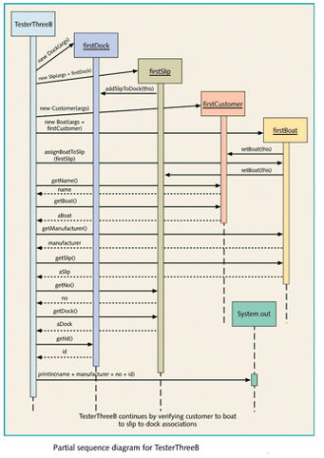

Slide 24
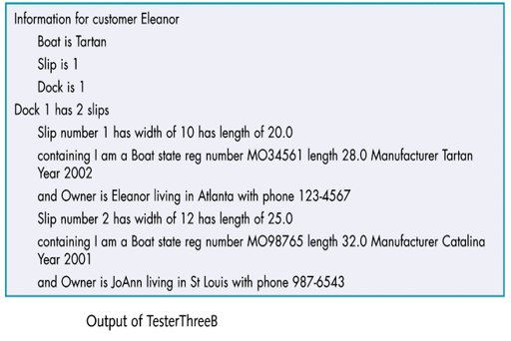

Slide 25
Creating and Using an Association Class - Lease
Association class
  Lease is an association between a customer and a slip, but with additional attributes to characterize the lease agreement
  To implement :
    Lease modified to include Slip and Customer reference attributes
    Slip modified to include a Lease reference attribute
  Class diagram
    Shows relationships between classes
  TesterFour
    Provides a comprehensive test of overall Lease associations
  Sequence diagram
    Illustrates the interaction in TesterFour

Slide 26
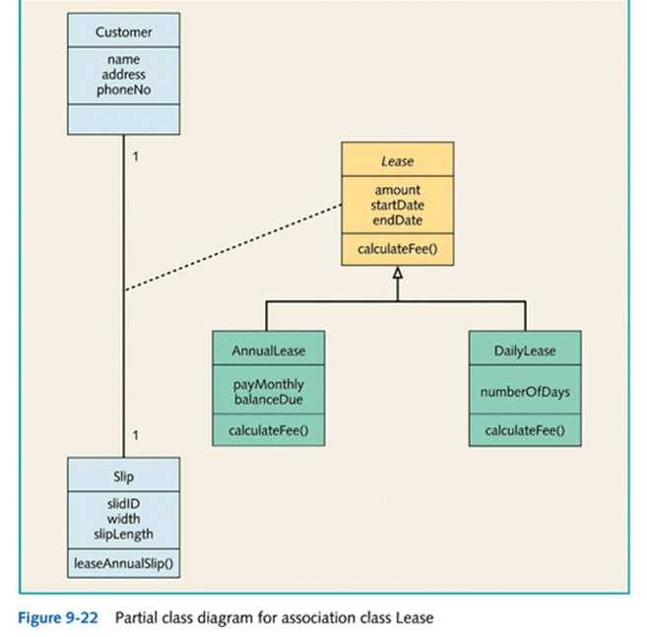

Slide 27
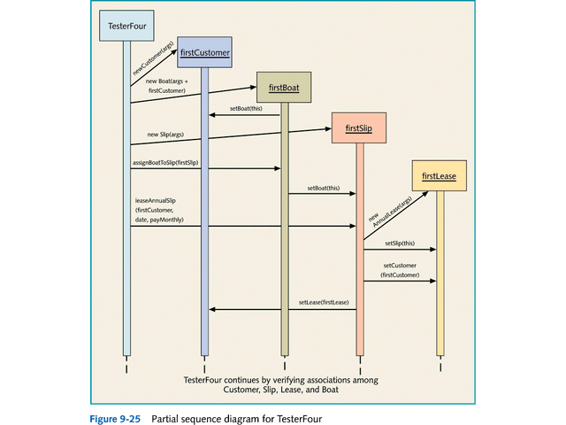

Slide 28
